Slide 1
Protecting Hospitals from Digital Threats
YWCC 307 Team Project

Slide 2
Why Cybersecurity Matters in Healthcare
Healthcare breaches cost $10.93M on average per incident.
Hospitals manage sensitive patient data and critical systems.
Cyberattacks can disrupt patient care and risk lives.
Notes:
"Good [morning/afternoon], everyone. Today, I’ll be talking about why cybersecurity is no longer just an IT concern in healthcare—it's a critical part of patient safety.
Healthcare breaches cost an average of $10.93 million per incident, the highest across all industries. Hospitals aren’t just protecting data—they’re protecting people’s lives. When systems go down, surgeries get delayed, treatments are paused, and patient trust erodes. This makes cybersecurity not optional, but essential."

Slide 3
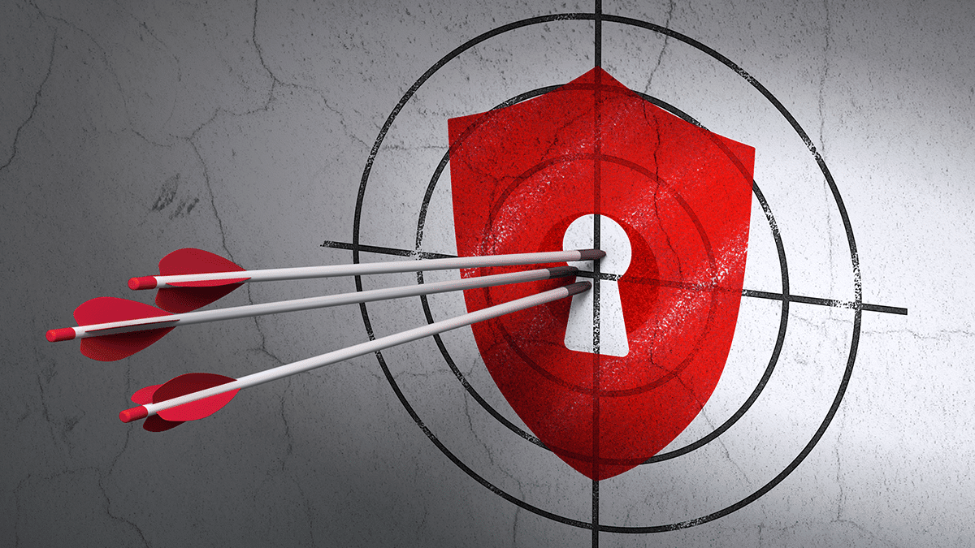
The Rising Threat Landscape
Expansion of connected devices increases risks.
Supply chain vulnerabilities are growing.
Healthcare is the #1 targeted industry for ransomware attacks.
Notes:
"Healthcare has unfortunately become the #1 target for ransomware attacks. Why? Because the stakes are so high.
At the same time, the expansion of connected medical devices, like insulin pumps and heart monitors, increases vulnerabilities. And supply chain attacks—where hackers go after third-party vendors—are growing more common. This combination of high value and high vulnerability makes healthcare a perfect storm for attackers."

Slide 4
Key Threats
Ransomware Attacks
37% Growth from 2020-2024
Phishing Campaigns
Data Breaches
IT Vulnerabilities
Notes:
"Let’s take a look at the most common threats hospitals face.
First, ransomware—up by 37% from 2020 to 2024—locks down entire hospital systems. Then there’s phishing, where deceptive emails trick staff into giving away passwords. Data breaches follow, with stolen medical records often selling for 10 times more than credit card info. And finally, IoT vulnerabilities—many devices run outdated or unsecured software, opening the door for attackers."

Slide 5
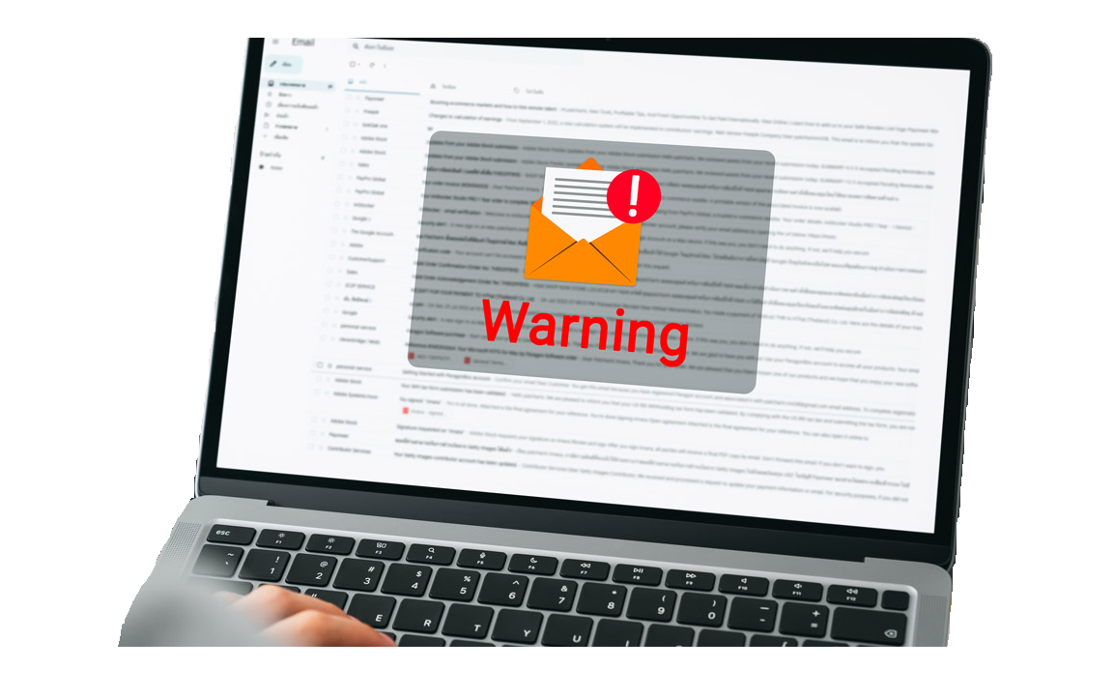
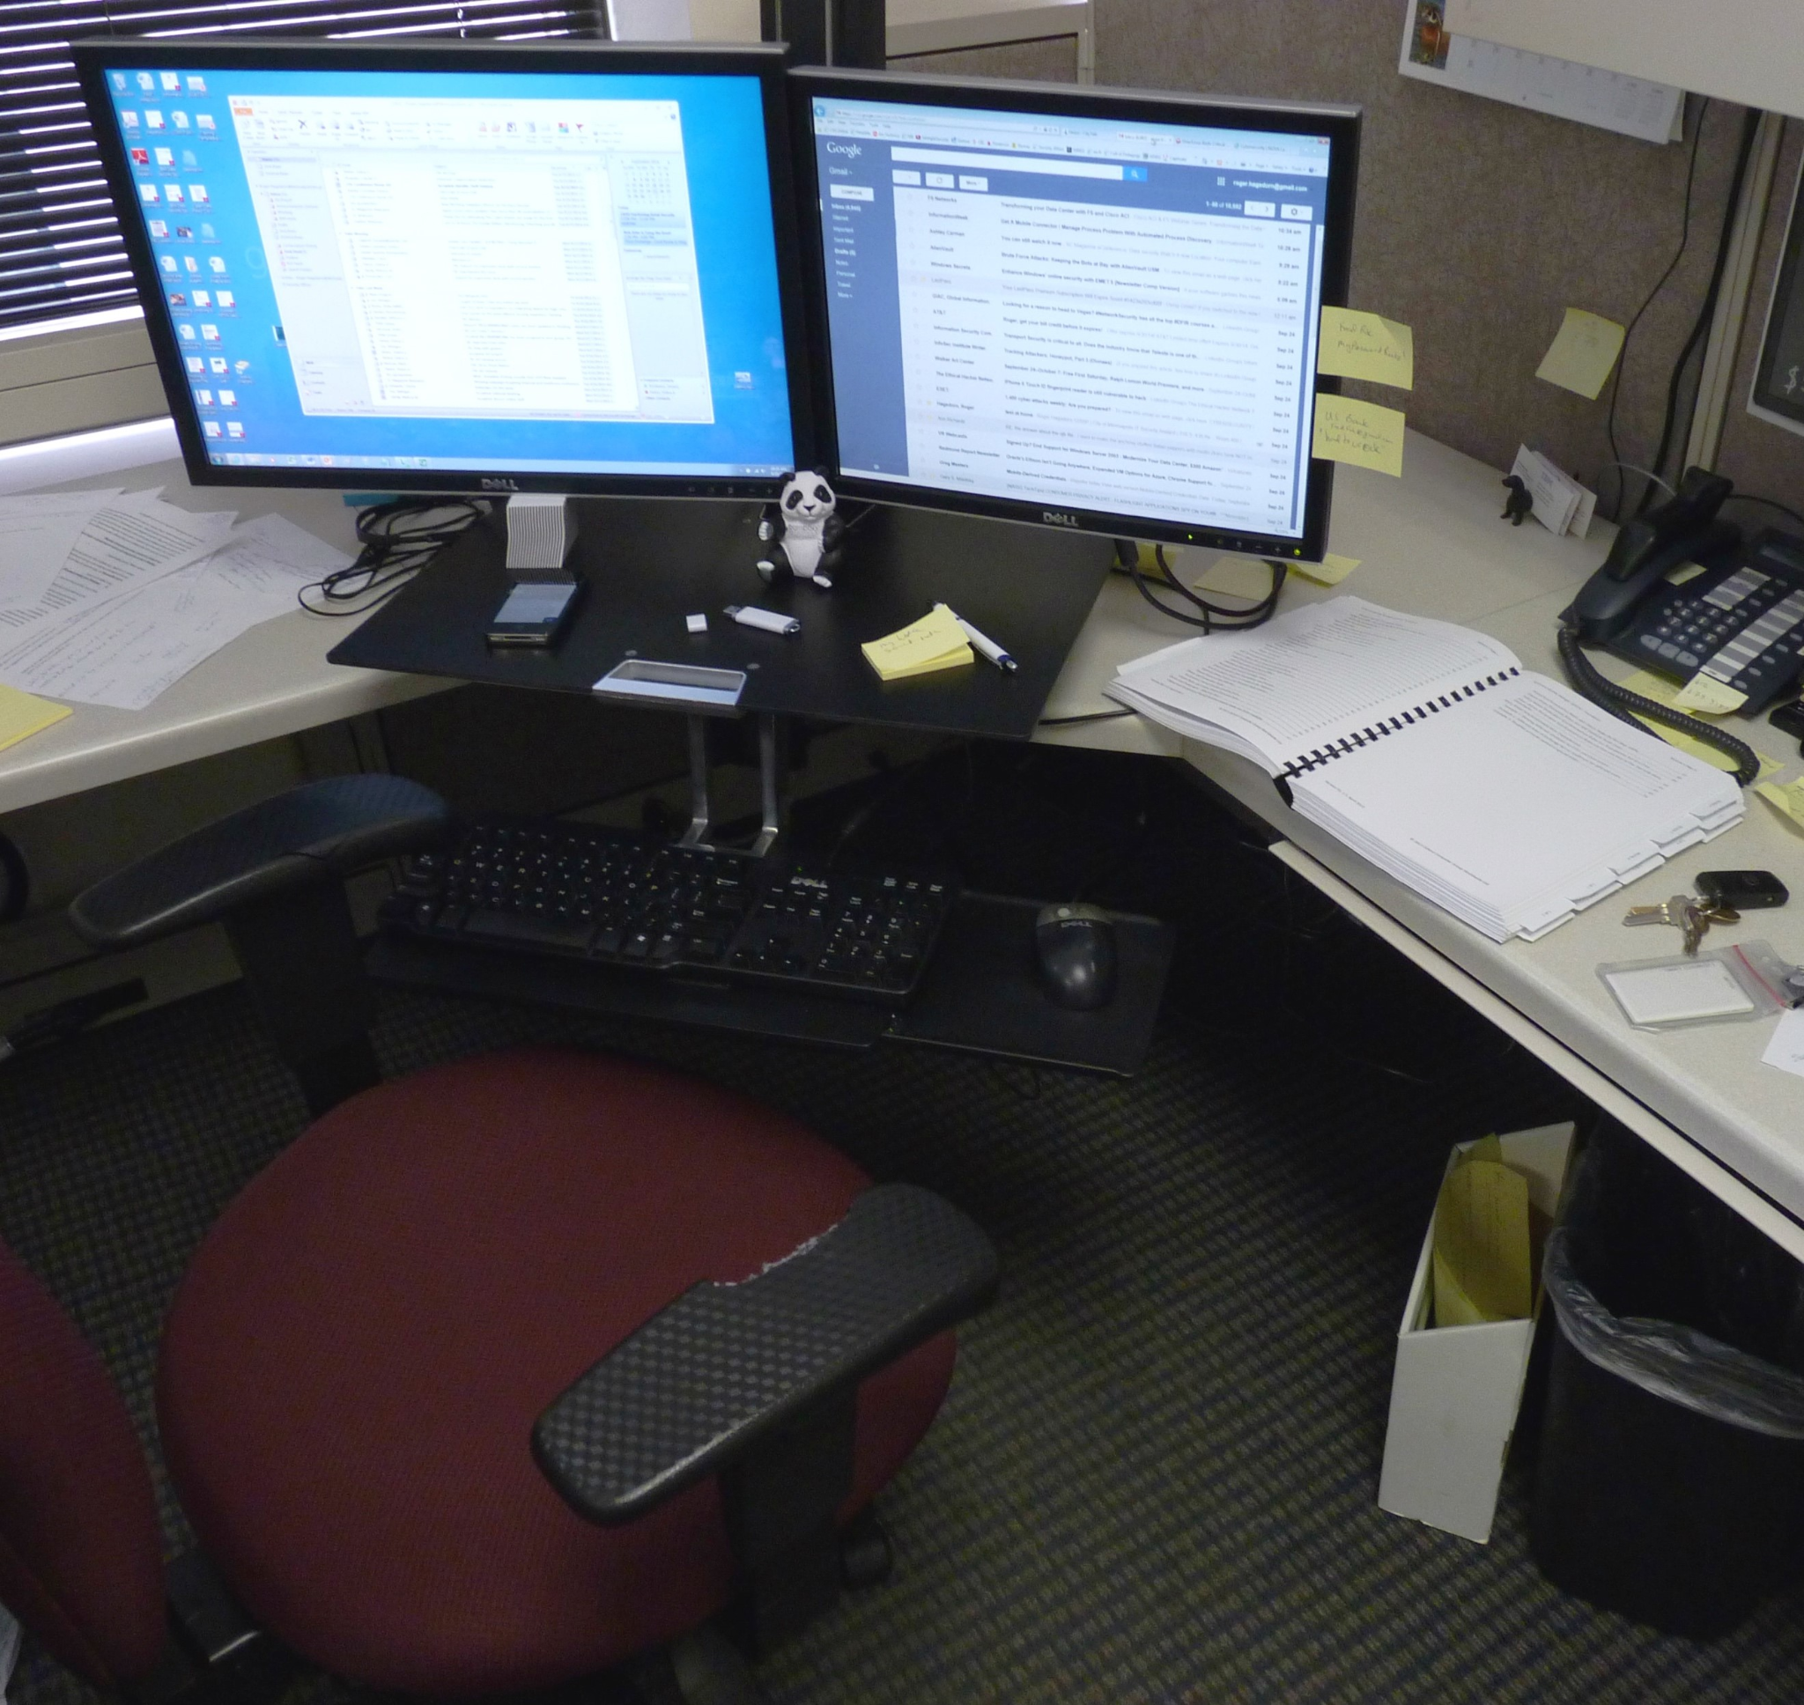
Modes of Attack
Email Spoofing and Phishing
Unsecured Devices
Social Engineering
Supply Chain Breaches
Notes:
"Now, how do these attacks happen?
A big one is email spoofing—attackers pose as trusted sources to gain access. Hospitals also use unsecured devices or outdated software, which are easy for hackers to exploit. Then there's social engineering, where attackers manipulate staff through phone calls or emails. And of course, supply chain breaches, where third-party vendors are targeted as weak links."

Slide 6

Case Study: WannaCry Ransomware
2017: Hit UK's NHS hospitals.
Cost over $120 million in damages.
Highlighted weaknesses in outdated systems.
Notes:
"A real-world example is the WannaCry ransomware attack in 2017.
It hit the UK’s NHS hard, canceling thousands of appointments and costing over $120 million. Many systems had skipped basic software updates, which allowed the malware to spread rapidly. This incident revealed just how devastating even a single cyberattack can be for a health system."

Slide 7
Preparing for Cyber Threats
Employee Cybersecurity Training
Multi-Factor Authentication (MFA)
Network Segmentation
Regular Software Updates
Notes:
"So how can hospitals prepare?
First, employee training—staff must learn to recognize phishing emails and report them. Then implement multi-factor authentication, so that passwords alone aren’t enough. Network segmentation is also crucial—it isolates systems, so if one part is compromised, it doesn’t spread. Finally, regular software updates—many breaches come through known vulnerabilities that just weren’t patched."

Slide 8
Strengthening Hospital Systems
Vendor Risk Management
Frequent Secure Backups
Incident Response Planning
Penetration Testing
Notes:
"Beyond that, hospitals need to harden their infrastructure.
They must manage vendor risk—not all third parties have strong cybersecurity. They also need secure daily backups, kept off-site, to allow for quick recovery. Having an incident response plan in place means everyone knows what to do when something happens. And regular penetration testing—ethical hacking—helps find weaknesses before the criminals do."

Slide 9

Modern Strategies
Continuous Monitoring
Security Awareness Culture
Zero Trust Architecture
Notes:
"Modern cybersecurity also requires a mindset shift.
Continuous monitoring helps detect suspicious activity early. Promoting a security-aware culture ensures every staff member plays a part. And adopting a Zero Trust Architecture—which assumes no device or user is automatically trusted—adds an extra layer of protection by limiting access until verified."

Slide 10
Successful Defense Example
California hospital in 2022 avoided paying ransom.
Quick isolation and recovery from secure backups.
Effective staff training and response planning.
Notes:
"Let’s look at a success story.
In 2022, a California hospital stopped a ransomware attack. Their staff recognized a suspicious email, reported it immediately, and IT teams segmented and isolated the network. They restored everything from secure backups in under 48 hours. No ransom was paid. This proves that preparation works—and it saves time, money, and potentially lives."

Slide 11
Conclusion
Cybersecurity is essential for patient safety.
Preparation today protects lives tomorrow.
Hospitals must invest in layered defenses.
Notes:
"In conclusion, cybersecurity is patient safety.
Hospitals can no longer treat it as an afterthought. The threats are real, the consequences are high—but so are the solutions. By investing in training, technology, and layered defense strategies, hospitals can prevent attacks and build trust with the communities they serve.
Preparing today protects lives tomorrow—and that’s a mission every healthcare provider should stand behind.
Thank you."

Slide 12
Thank You

Slide 13
Resources
https://www.chiefhealthcareexecutive.com/view/average-cost-of-healthcare-data-breach-rises-to-nearly-11m
https://www.fiercehealthcare.com/health-tech/healthcare-remains-top-target-cybercriminals-uptick-hacking-attacks-2024
https://cybelangel.com/healthcare-industry-guide-cyber/
https://www.cyberpolicy.com/cybersecurity-education/why-medical-records-are-10-times-more-valuable-than-credit-card-info

